Slide 1


Network protocols & security
24EC2210
Topic:
Network hardware
Session - 2

Slide 2



AIM OF THE SESSION
To familiarize students with the network hardware concepts.
INSTRUCTIONAL OBJECTIVES
This Session is designed to:
Demonstrate the network transmission technologies.
Describe different types of networks based on geographical area or scale.
LEARNING OUTCOMES
At the end of this session, you should be able to:
Illustrate different types of networks based on transmission technology.
Categorize networks based on geographical area.

Slide 3
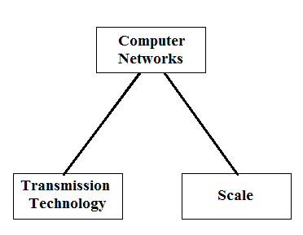
SESSION INTRODUCTION
Network Hardware:
Deals with technical issues involved in network design.
Two dimensions:
Transmission technology
Scale.
A Computer Network consists of a collection of computers, printers and other equipment that is connected together so that they can communicate with
each other

Slide 4
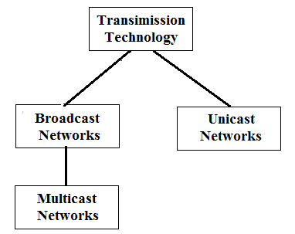
Transmission is actually the process of sending and propagating signals of digital information. Transmission technology generally refers to physical layer protocol duties like modulation, demodulation, line coding, etc.
TRANSMISSION TECHNOLOGY

Slide 5
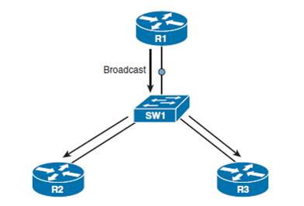
Transmission Technology…
Broadcast Networks:
Have single communication channel that is shared by all the machines on the network.
Data is sent to all the nodes/stations in the network domain.
Short messages(Packets) sent by any machine are received by all the others.
A special broadcast address exist for every network which is used to receive a broadcasted message.
Example: Address Resolution Protocol (ARP) requests.

Slide 6
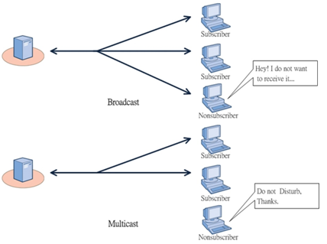
Transmission Technology…
Multicast Networks:
Some broadcast systems also support transmission to a subset of the machines, known as multicasting.
One possible scheme is to reserve one bit to indicate multicasting. The remaining n-1 address bits can hold a group number.
When a packet is sent to a certain group, it is delivered to all machines subscribing to that group.
Example: 1. Video conferencing,
2. Sending a message targeting number of people at at a time.

Slide 7

Transmission Technology…
Point-to-Point Networks:
Point-to-point networks consist of many connections between individual pairs of machines.
Often multiple routes, of different lengths, are possible, so finding good ones is important in point-to-point networks.
Usually, smaller geographically localized networks tend to use broadcasting, whereas larger networks usually are point-to-point.
Point-to-point transmission with one sender and one receiver is sometimes called Unicasting.
Example: Cell phone conversation.

Slide 8
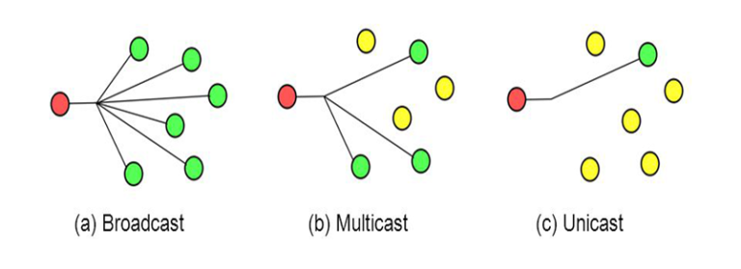
Transmission Technology…

Slide 9
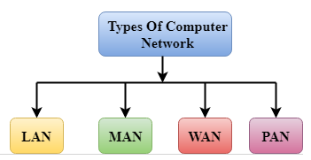
COMPUTER NETWORKS BASED ON SCALE
A computer network can be categorized by their size.
Four types:
PAN(Personal Area Network)
LAN(Local Area Network)
MAN(Metropolitan Area Network)
WAN(Wide Area Network)

Slide 10
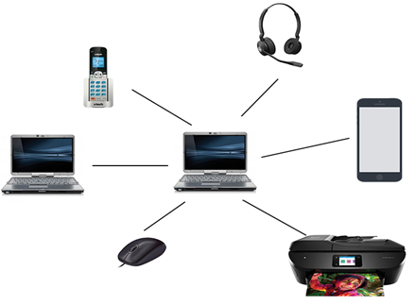
PAN (Personal Area Network)
Personal Area Network is a network arranged within an individual person, typically within a range of 1 to 10 meters.
PAN is used for connecting the computer devices of personal use.
Personal computer devices that are used to develop the personal area network are the laptop, mobile phones, media player and play stations.
There are two types of Personal Area Network:
Wired Personal Area Network (USB)
Wireless Personal Area Network (Wifi, Bluetooth, etc)

Slide 11
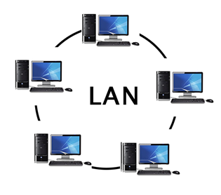
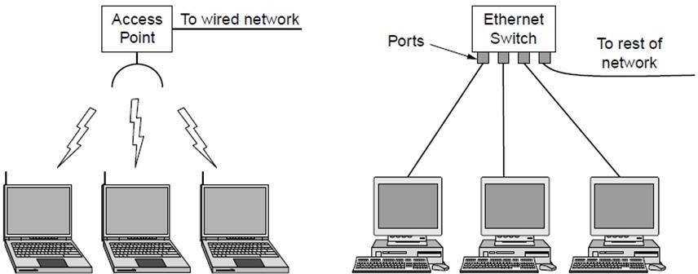
LAN (Local Area Network)
Local Area Network is a group of computers connected to each other in a small area such as building, office.
LAN is used for connecting two or more personal computers through a communication medium such as twisted pair, coaxial cable, etc.
It is less costly as it is built with inexpensive hardware such as hubs, network adapters, and ethernet cables.
The data is transferred at an extremely faster rate in Local Area Network.
Local Area Network provides higher security

Slide 12
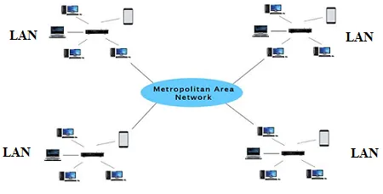
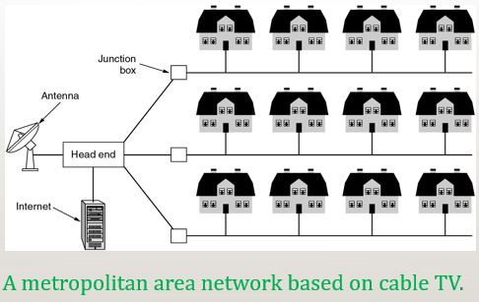
MAN (Metropolitan Area Network)
A metropolitan area network is a network that covers a larger geographic area by interconnecting different LANs to form a larger network.
In MAN, various LANs are connected to each other through a telephone exchange line.
Government agencies use MAN to connect to the citizens and private industries.
It has a higher range than Local Area Network(LAN).
Uses of MAN:
Used in communication between the banks in a city.
It can be used in an Airline Reservation.
It can be used in a college within a city.
It can also be used for communication in the military.

Slide 13
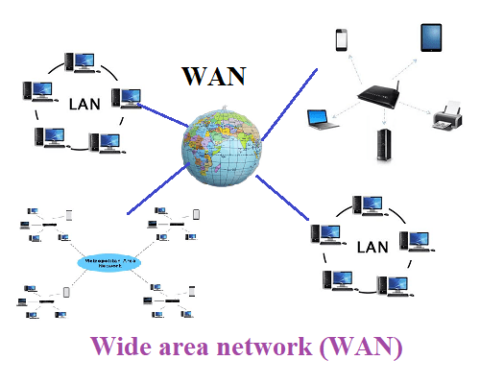
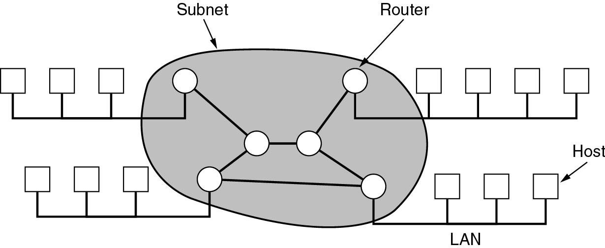
WAN (Wide Area Network)
A Wide Area Network is a network that extends over a large geographical area such as states or countries.
A Wide Area Network is quite bigger network than the LAN and MAN.
WAN is not limited to a single location, but it spans over a large geographical area through a telephone line, fibre optic cable or satellite links.
WAN is widely used in the field of Business, government, and education.

Slide 14
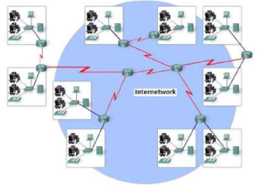
Internetwork / Internet
LANs and WANs may be interconnected into an internetwork – a global mesh of interconnected computer networks.
An interconnection between public, private, commercial, industrial, or government computer networks can also be defined as internetworking.
An internetworking uses the internet protocol.
The reference model used for internetworking is Open System Interconnection(OSI).

Slide 15
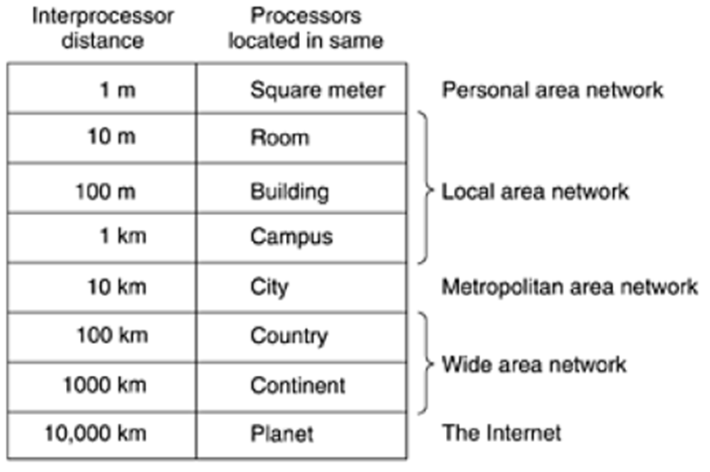

Slide 16
SELF-ASSESSMENT QUESTIONS
1. Two or more computers connected close together in a local area e.g. building or office is called?
PAN
LAN
MAN
WAN
2. Which of the following shows the correct arrangement of networks from the smallest to the largest network?
WAN, LAN, MAN
LAN, MAN, WAN
WAN, MAN, LAN
LAN, WAN, MAN
3. What is the purpose of a WAN?
To allow computers to communicate with each other in the same area
To allow computers to communicate with each other - anywhere in the world

Slide 17
SELF-ASSESSMENT QUESTIONS: Answers
1. Two or more computers connected close together in a local area e.g. building or office is called?
PAN
MAN
LAN
WAN
2. Which of the following shows the correct arrangement of networks from the smallest to the largest network?
WAN, LAN, MAN
LAN, MAN, WAN
WAN, MAN, LAN
LAN, WAN, MAN
3. What is the purpose of a WAN?
To allow computers to communicate with each other in the same area
To allow computers to communicate with each other - anywhere in the world

Slide 18

Topic Summary
Network types based on Technology
Network types based on Geographical Scale

Slide 19
TERMINAL QUESTIONS
1. Describe the network types based on transmission technology.
2. Describe the network types based on their scale.

Slide 20
REFERENCES FOR FURTHER LEARNING OF THE SESSION
Reference Books:
A.S. Tanenbaum, David J. Wetheral “Computer Networks” Pearson, 5th Edition.
Kurose, J and Ross, K Computer Networking: A Top-Down Approach Addison-Wesley- 6th edition.
Sites and Web links:
https://www.geeksforgeeks.org/types-of-transmission-technology/
https://www.tutorialspoint.com/data_communication_computer_network/computer_network_topologies.htm
3. https://www.javatpoint.com/computer-network-transmission-modes

Slide 21
THANK YOU
Team – Network Protocols & Security

